Slide 1
Movie seat reservation system
-Uppala Jathin -Dr.Gayathri Devi.S
-22BCE5188

Slide 2
INTRODUCTION
The Online Movie Seat Reservation System is a web-based application designed to simplify the process of
booking movie tickets. Developed using PHP and MySQL with XAMPP as the server environment, the
system enables users to view available movies, select showtimes, and reserve seats in real time. It eliminates the
need for in-person bookings or phone calls, offering a seamless and efficient user experience. The admin
interface allows theater management to handle movie listings, showtimes, and seat availability. This project aims
to enhance convenience for moviegoers and improve operational efficiency for theater operators.

Slide 3
PROBLEM STATEMENT
With the growing demand for online services and digital transformation, traditional methods of booking movie tickets, such as visiting a theater in person or making phone calls, are becoming increasingly inefficient. Moviegoers often face long queues, confusion regarding seat availability, and the inconvenience of manually reserving seats. Moreover, theater management struggles to maintain an up-to-date record of seat availability and manage bookings effectively.
To address these issues, we propose the development of an Online Movie Seat Reservation System that allows customers to book movie tickets and select their preferred seats conveniently from anywhere at any time via the internet. This system will utilize a PHP-based web application, hosted on XAMPP (using Apache and MySQL) to manage data storage and retrieval. The system will provide an intuitive user interface, enabling users to view available movies, select showtimes, and choose seats in real-time, all while ensuring efficient seat allocation for the theater's management.

Slide 4
RESEARCH OBJECTIVE
The main objective of this research is to design, develop, and evaluate an Online Movie
SeatReservation System using PHP, MySQL, and XAMPP. The specific objectives of this research are:
To design a user-friendly interface that allows customers to easily browse movies, view showtimes, and reserve seats in real time.
To develop a real-time seat management system that ensures accurate seat availability, preventing double bookings and minimizing errors.
To implement a secure user authentication system for user registration and login, enabling personalized booking experiences.
To create an admin panel for theater operators to manage movie listings, showtimes, and booking records efficiently.
To analyze the effectiveness of the system in improving the efficiency of movie seat reservations and enhancing customer satisfaction.
To evaluate the system’s performance, scalability, and security in handling concurrent bookings and large datasets.

Slide 5
PROPOSED SYSTEM
The proposed Online Movie Seat Reservation System is a web-based platform that allows users to conveniently book movie tickets and select their seats in real time. Developed using PHP MySQL and XAMPP, the system consists of two main components: the user interface and the admin panel
For users, the system provides an intuitive interface to browse movies, view showtimes, and select available seats. Users can complete the booking process by registering, logging in, and confirming reservations. The admin panel allows theater operators to manage movie listings, showtimes, seat availability, and user bookings.
The system includes real-time seat management to ensure accurate seat availability, preventing double bookings. Additionally, the secure login system and database management protect user data. The proposed system enhances the moviegoing experience by offering convenience for users and efficiency for theater operators, reducing manual errors and operational overhead.

Slide 6
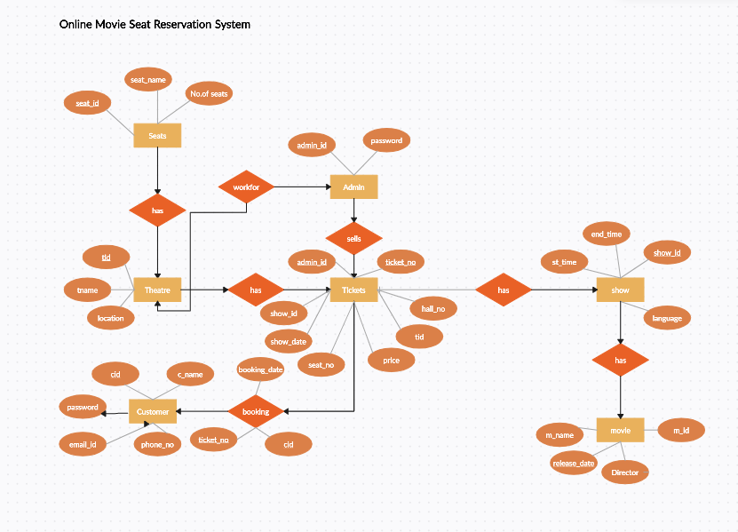
ER DIAGRAM

Slide 7
Modules USED
User Authentication (Login, Registration, Session Management)
Movie and Showtime Management (Add/Update/Remove Movies, Showtimes)
Booking Management (Ticket Booking)
Admin Management (Movie/Showtime/Booking)
User Profile Management (Profile, History)
Theater Management (Manage Theaters and Seat Configurations)

Slide 8
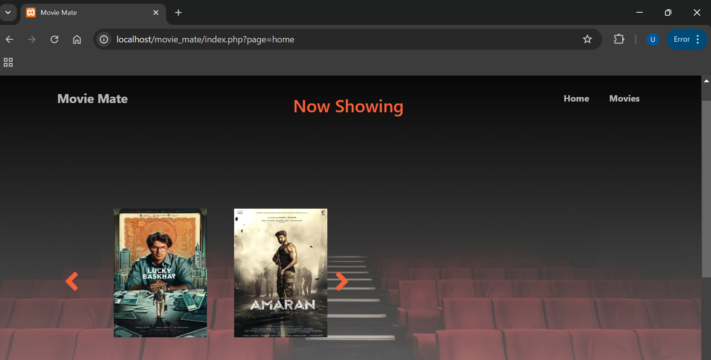

Slide 9
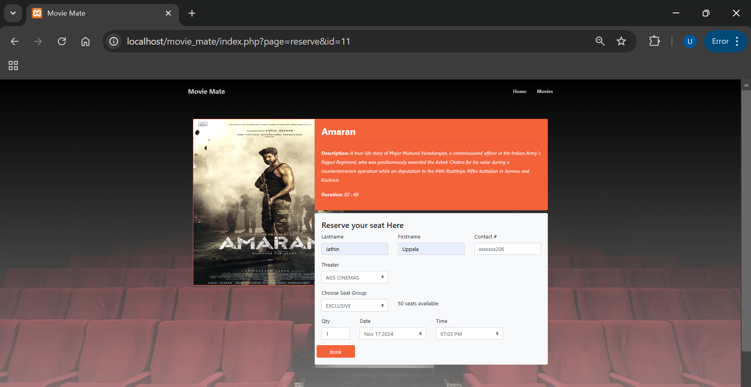

Slide 10
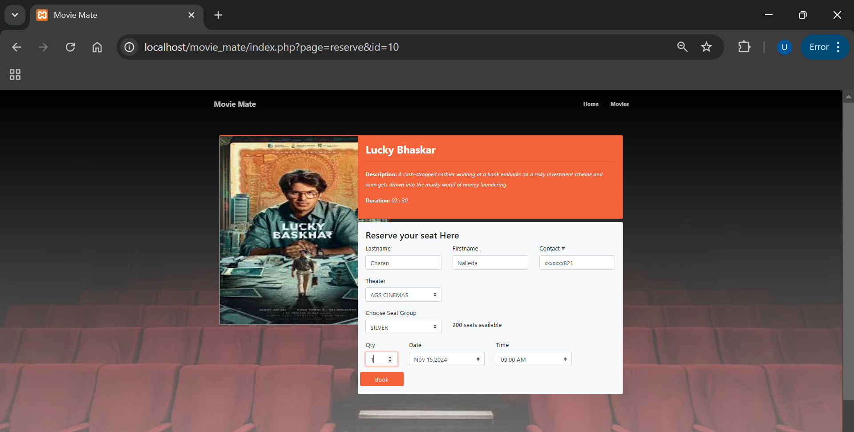

Slide 11
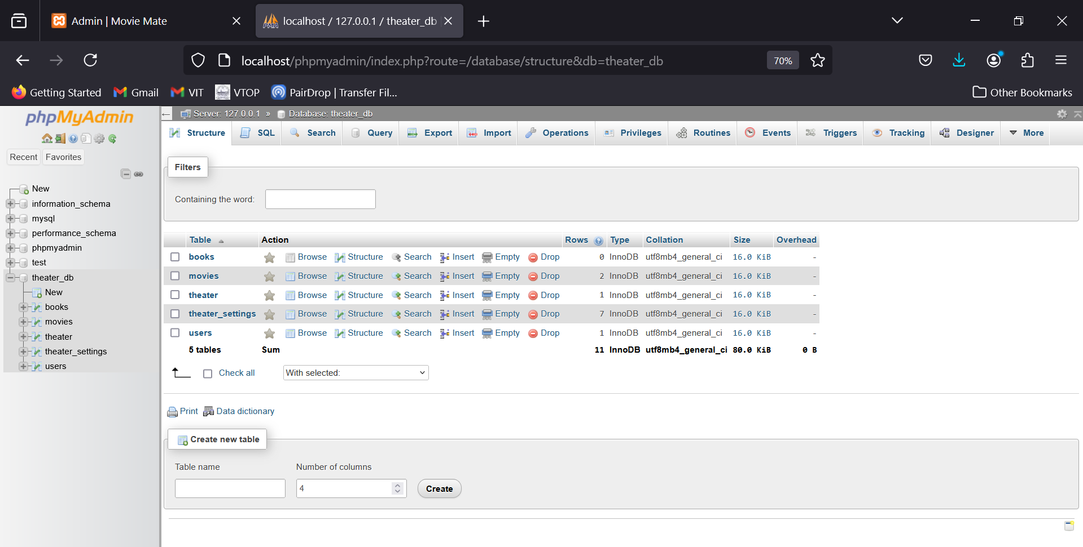

Slide 12
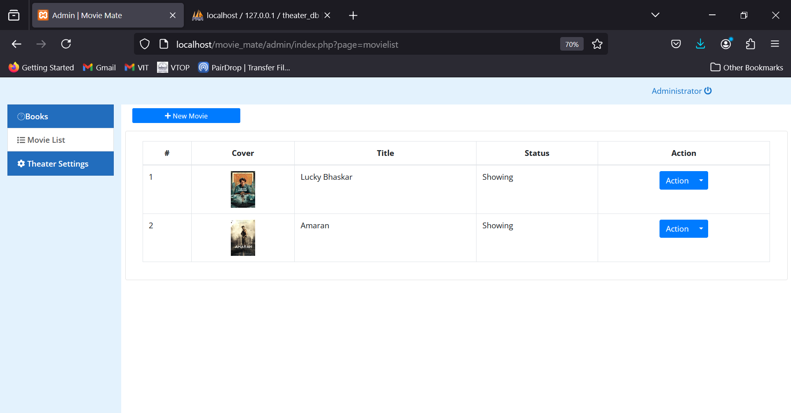

Slide 13
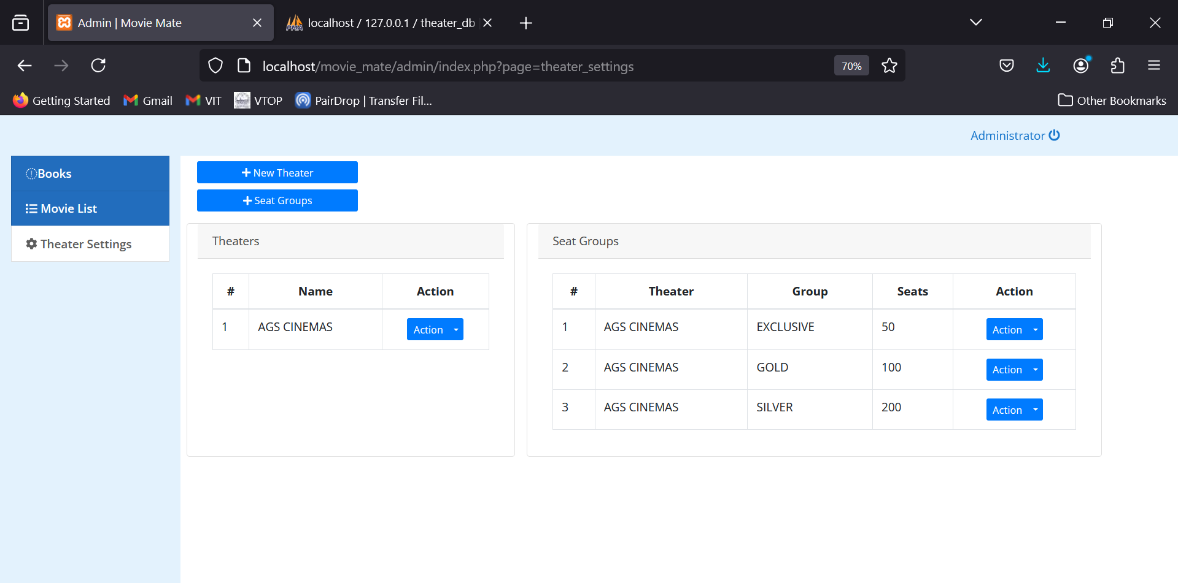

Slide 14
CONCLUSION AND FUTURE WORK
The project successfully addresses the common challenges of traditional booking methods, such as long queues, seat unavailability, and manual errors, by automating the booking process. Moreover, the admin panel enhances the management of movie listings, bookings, and user data, thereby improving the overall user experience and theater operations.
While the Online Movie Seat Reservation System meets its primary objectives, there are several areas where the system can be enhanced for greater functionality and user experience:
Mobile Application Development:
Advanced Payment Integration:
Recommendation System:
Real-Time Notifications:
Multiple Theater Support:
Enhanced Security Features:

Slide 15
REFERENCES
MySQL Documentation
URL: https://dev.mysql.com/doc/
XAMPP Documentation
URL: https://www.apachefriends.org/index.html
https://www.researchgate.net/publication/380983054_A_CASE_STUDY_ON_ONLINE_TICKET_BOOKING_SYSTEM_PROJECT

